Slide 1

W4111 – 02: Introduction to Databases
Lecture 3,4: ER Modeling, SQL, Relational
Donald F. Ferguson dff9@Columbia.edu
TRANSCENDING DISCIPLINES, TRANSFORMING LIVES

Slide 2

Project Context Slides
2 | W4111_02_S20: Introduction to Databases -- Lecture 3,4

Slide 3
Homework/Project Directions: Programming, No-Programming
Analytics Reports
Web Application
Data Sources:
IMDB TSV loaded into MySQL in cloud by DFF.
Some CSV and JSON files.
REST API calls.
… …
Data Environment/Subsystem
Analytics
Operational
Integrate
Homework/Project Approach:
DFF and TAs with provide helper code, some data/databases, helper code/libraries, implementation template.
Both tracks will cover the same core: databases, data models, queries, data transformation, … …
Programming Track: REST API, web application, code to manage/transform data, …
No-Programming: More complex data models/schema, using DML to load and transform, …
Comments:
We will have to figure this out as we go. I have never done two tracks before … …
My sections of this course will continue to emphasize practical, hands-on, … …, but will cover theory.
3 | W4111_02_S20: Introduction to Databases -- Lecture 5

Slide 4
How Will this Work in Practices
Browser
Analytics Reports
Web Application
REST API
Content and Controllers
Multi-Databse/Cloud API and Views
Relational Data Environment/Subsystem
Graph
Data Environment
Other Data Environment
… …
… …
Analytics
Operational
Integrate
4 | W4111_02_S20: Introduction to Databases -- Lecture 5

Slide 5
REST
5 | W4111_02_S20: Introduction to Databases -- Lecture 3,4

Slide 6
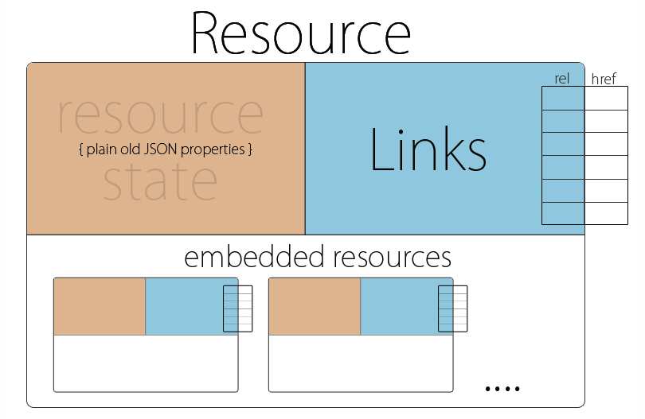
REST Model
Example: Linked Data and SPARQL
Example:
HAL - Hypertext Application Language
6 | W4111_02_S20: Introduction to Databases -- Lecture 5

Slide 7
JOIN
7 | W4111_02_S20: Introduction to Databases -- Lecture 3,4

Slide 8
Joined Relations
Join operations take two relations and return as a result another relation.
A join operation is a Cartesian product which requires that tuples in the two relations match (under some condition). It also specifies the attributes that are present in the result of the join
The join operations are typically used as subquery expressions in the from clause
Three types of joins:
Natural join
Inner join
Outer join

Slide 9
Natural Join in SQL
Natural join matches tuples with the same values for all common attributes, and retains only one copy of each common column.
List the names of instructors along with the course ID of the courses that they taught
select name, course_id from students, takes where student.ID = takes.ID;
Same query in SQL with “natural join” construct
select name, course_id from student natural join takes;

Slide 10
Natural Join in SQL (Cont.)
The from clause can have multiple relations combined using natural join:
select A₁, A₂, … A_{n} from r₁ natural join r₂ natural join .. natural join r_{n} where P ;

Slide 11
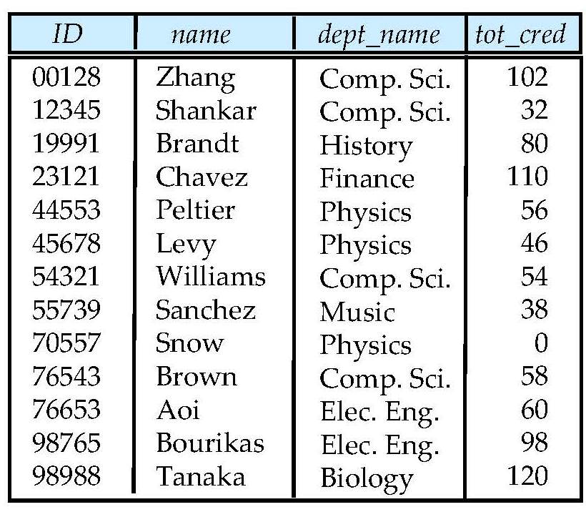
Student Relation

Slide 12
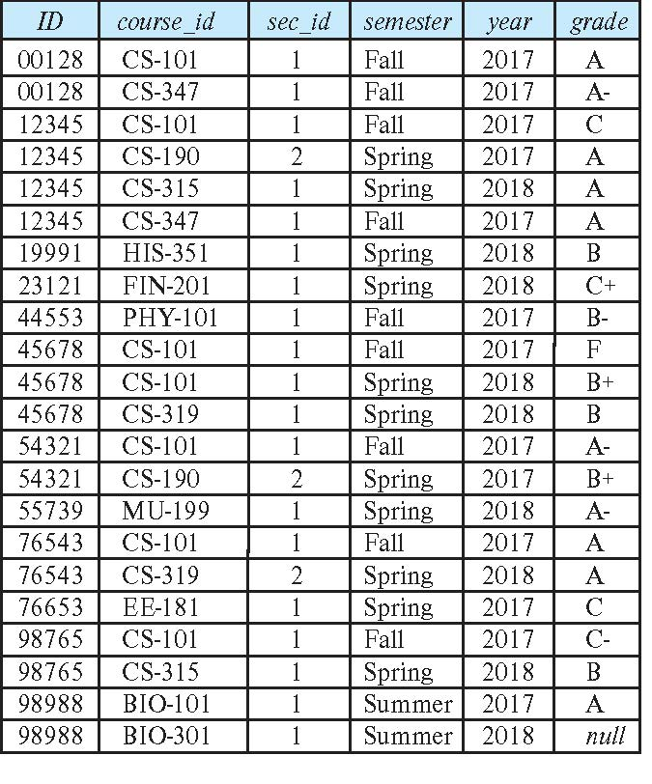
Takes Relation

Slide 13
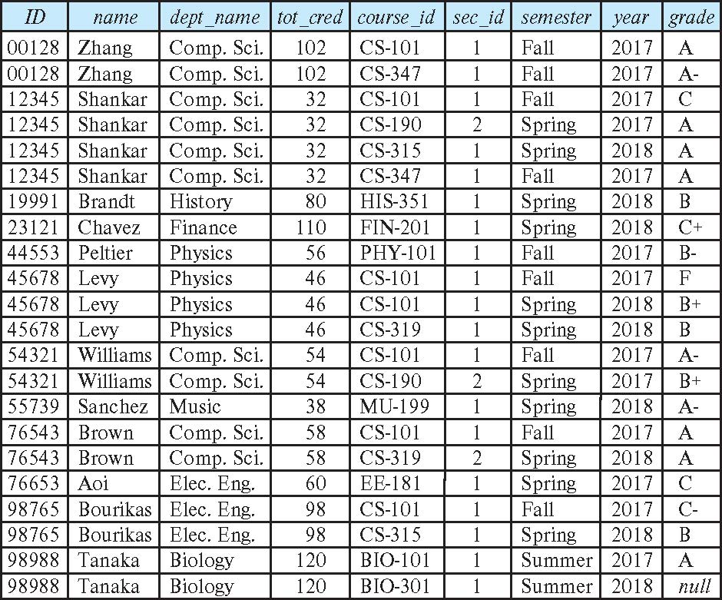
student natural join takes

Slide 14
Dangerous in Natural Join
Beware of unrelated attributes with same name which get equated incorrectly
Example -- List the names of students instructors along with the titles of courses that they have taken
Correct version
select name, title from student natural join takes, course where takes.course_id = course.course_id;
Incorrect version
select name, title from student natural join takes natural join course;
This query omits all (student name, course title) pairs where the student takes a course in a department other than the student's own department.
The correct version (above), correctly outputs such pairs.

Slide 15
Natural Join with Using Clause
To avoid the danger of equating attributes erroneously, we can use the “using” construct that allows us to specify exactly which columns should be equated.
Query example
select name, title from (student natural join takes) join course using (course_id)

Slide 16
Join Condition
The on condition allows a general predicate over the relations being joined
This predicate is written like a where clause predicate except for the use of the keyword on
Query example
select * from student join takes on student_ID = takes_ID
The on condition above specifies that a tuple from student matches a tuple from takes if their ID values are equal.
Equivalent to:
select * from student , takes where student_ID = takes_ID

Slide 17
Join Condition (Cont.)
The on condition allows a general predicate over the relations being joined.
This predicate is written like a where clause predicate except for the use of the keyword on.
Query example
select * from student join takes on student_ID = takes_ID
The on condition above specifies that a tuple from student matches a tuple from takes if their ID values are equal.
Equivalent to:
select * from student , takes where student_ID = takes_ID

Slide 18
Outer Join
An extension of the join operation that avoids loss of information.
Computes the join and then adds tuples form one relation that does not match tuples in the other relation to the result of the join.
Uses null values.
Three forms of outer join:
left outer join
right outer join
full outer join

Slide 19
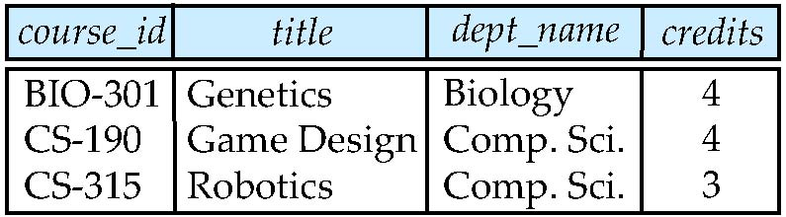
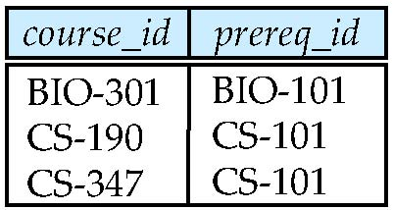
Outer Join Examples
Relation course
Relation prereq
Observe that
course information is missing CS-437
prereq information is missing CS-315
x

Slide 20
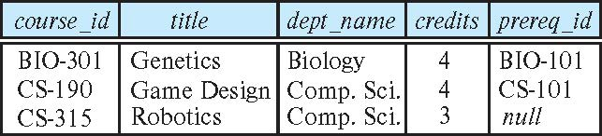
Left Outer Join
course natural left outer join prereq
In relational algebra: course ⟕ prereq

Slide 21
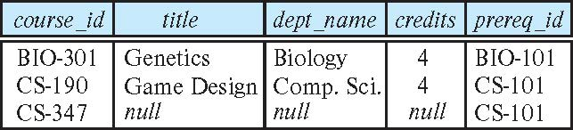
Right Outer Join
course natural right outer join prereq
In relational algebra: course ⟖ prereq

Slide 22
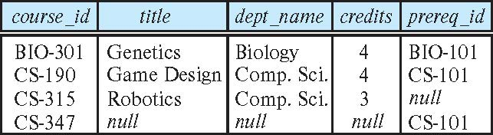
Full Outer Join
course natural full outer join prereq
In relational algebra: course ⟗ prereq

Slide 23
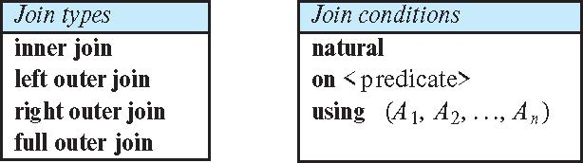
Joined Types and Conditions
Join operations take two relations and return as a result another relation.
These additional operations are typically used as subquery expressions in the from clause
Join condition – defines which tuples in the two relations match.
Join type – defines how tuples in each relation that do not match any tuple in the other relation (based on the join condition) are treated.

Slide 24
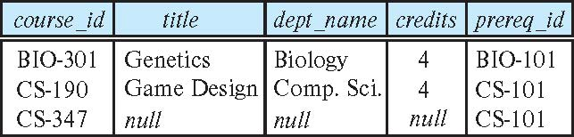
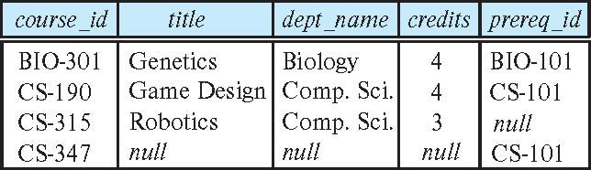
Joined Relations – Examples
course natural right outer join prereq
course full outer join prereq using (course_id)

Slide 25
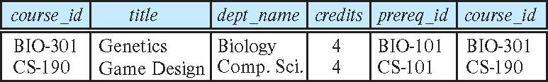
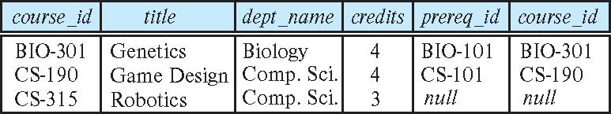
Joined Relations – Examples
course inner join prereq on course.course_id = prereq.course_id
What is the difference between the above, and a natural join?
course left outer join prereq on course.course_id = prereq.course_id

Slide 26
Joined Relations – Examples
course natural right outer join prereq
course full outer join prereq using (course_id)

Slide 27
How to Think About Joins
Remember
The rows in the result are of the form: {ai, aj, am, b1,b7,b11}
Represent a pair of rows that “matched” on JOIN condition.
The way to think about these set diagrams is:
The cartesian product is all possible pairs of rows.
The JOINs represent the subsets of the cartesian product.
27 | W4111_02_S20: Introduction to Databases -- Lecture 3,4

Slide 28
Views
In some cases, it is not desirable for all users to see the entire logical model (that is, all the actual relations stored in the database.)
Consider a person who needs to know an instructors name and department, but not the salary. This person should see a relation described, in SQL, by select ID, name, dept_name from instructor
A view provides a mechanism to hide certain data from the view of certain users.
Any relation that is not of the conceptual model but is made visible to a user as a “virtual relation” is called a view.

Slide 29
View Definition
A view is defined using the create view statement which has the form
create view v as < query expression >
where <query expression> is any legal SQL expression. The view name is represented by v.
Once a view is defined, the view name can be used to refer to the virtual relation that the view generates.
View definition is not the same as creating a new relation by evaluating the query expression
Rather, a view definition causes the saving of an expression; the expression is substituted into queries using the view.

Slide 30
View Definition and Use
A view of instructors without their salary
create view faculty as select ID, name, dept_name from instructor
Find all instructors in the Biology department
select name from faculty where dept_name = 'Biology'
Create a view of department salary totals
create view departments_total_salary(dept_name, total_salary) as select dept_name, sum (salary) from instructor group by dept_name;

Slide 31
Views Defined Using Other Views
One view may be used in the expression defining another view
A view relation v₁ is said to depend directly on a view relation v₂ if v₂ is used in the expression defining v₁
A view relation v₁ is said to depend on view relation v₂ if either v₁ depends directly to v₂ or there is a path of dependencies from v₁ to v₂
A view relation v is said to be recursive if it depends on itself.

Slide 32
Views Defined Using Other Views
create view physics_fall_2017 as select course.course_id, sec_id, building, room_number from course, section where course.course_id = section.course_id and course.dept_name = 'Physics' and section.semester = 'Fall' and section.year = '2017’;
create view physics_fall_2017_watson as select course_id, room_number from physics_fall_2017 where building= 'Watson';

Slide 33
View Expansion
Expand the view :
create view physics_fall_2017_watson as select course_id, room_number from physics_fall_2017 where building= 'Watson'
To:
create view physics_fall_2017_watson as
select course_id, room_number
from (select course.course_id, building, room_number
from course, section
where course.course_id = section.course_id
and course.dept_name = 'Physics'
and section.semester = 'Fall'
and section.year = '2017')
where building= 'Watson';

Slide 34
View Expansion (Cont.)
A way to define the meaning of views defined in terms of other views.
Let view v₁ be defined by an expression e₁ that may itself contain uses of view relations.
View expansion of an expression repeats the following replacement step:
repeat Find any view relation v_{i} in e₁ Replace the view relation v_{i} by the expression defining v_{i} until no more view relations are present in e₁
As long as the view definitions are not recursive, this loop will terminate

Slide 35
Materialized Views
Certain database systems allow view relations to be physically stored.
Physical copy created when the view is defined.
Such views are called Materialized view:
If relations used in the query are updated, the materialized view result becomes out of date
Need to maintain the view, by updating the view whenever the underlying relations are updated.

Slide 36
Update of a View
Add a new tuple to faculty view which we defined earlier
insert into faculty
values ('30765', 'Green', 'Music');
This insertion must be represented by the insertion into the instructor relation
Must have a value for salary.
Two approaches
Reject the insert
Inset the tuple
('30765', 'Green', 'Music', null)
into the instructor relation

Slide 37
Some Updates Cannot be Translated Uniquely
create view instructor_info as select ID, name, building from instructor, department where instructor.dept_name= department.dept_name;
insert into instructor_info
values ('69987', 'White', 'Taylor');
Issues
Which department, if multiple departments in Taylor?
What if no department is in Taylor?

Slide 38
And Some Not at All
create view history_instructors as select * from instructor where dept_name= 'History';
What happens if we insert
('25566', 'Brown', 'Biology', 100000)
into history_instructors?

Slide 39
View Updates in SQL
Most SQL implementations allow updates only on simple views
The from clause has only one database relation.
The select clause contains only attribute names of the relation, and does not have any expressions, aggregates, or distinct specification.
Any attribute not listed in the select clause can be set to null
The query does not have a group by or having clause.

Slide 40
Integrity Constraints
Integrity constraints guard against accidental damage to the database, by ensuring that authorized changes to the database do not result in a loss of data consistency.
A checking account must have a balance greater than $10,000.00
A salary of a bank employee must be at least $4.00 an hour
A customer must have a (non-null) phone number

Slide 41
Constraints on a Single Relation
not null
primary key
unique
check (P), where P is a predicate

Slide 42
Not Null Constraints
not null
Declare name and budget to be not null
name varchar(20) not null budget numeric(12,2) not null

Slide 43
Unique Constraints
unique ( A₁, A₂, …, A_{m})
The unique specification states that the attributes A₁, A₂, …, A_{m} form a candidate key.
Candidate keys are permitted to be null (in contrast to primary keys).

Slide 44
The check clause
The check (P) clause specifies a predicate P that must be satisfied by every tuple in a relation.
Example: ensure that semester is one of fall, winter, spring or summer
create table section
(course_id varchar (8),
sec_id varchar (8),
semester varchar (6),
year numeric (4,0),
building varchar (15),
room_number varchar (7),
time slot id varchar (4),
primary key (course_id, sec_id, semester, year),
check (semester in ('Fall', 'Winter', 'Spring', 'Summer')))

Slide 45
Referential Integrity
Ensures that a value that appears in one relation for a given set of attributes also appears for a certain set of attributes in another relation.
Example: If “Biology” is a department name appearing in one of the tuples in the instructor relation, then there exists a tuple in the department relation for “Biology”.
Let A be a set of attributes. Let R and S be two relations that contain attributes A and where A is the primary key of S. A is said to be a foreign key of R if for any values of A appearing in R these values also appear in S.

Slide 46
Referential Integrity (Cont.)
Foreign keys can be specified as part of the SQL create table statement
foreign key (dept_name) references department
By default, a foreign key references the primary-key attributes of the referenced table.
SQL allows a list of attributes of the referenced relation to be specified explicitly.
foreign key (dept_name) references department (dept_name)

Slide 47
Cascading Actions in Referential Integrity
When a referential-integrity constraint is violated, the normal procedure is to reject the action that caused the violation.
An alternative, in case of delete or update is to cascade
create table course ( (… dept_name varchar(20), foreign key (dept_name) references department on delete cascade on update cascade, . . .)
Instead of cascade we can use :
set null,
set default

Slide 48
Integrity Constraint Violation During Transactions
Consider:
create table person ( ID char(10), name char(40), mother char(10), father char(10), primary key ID, foreign key father references person, foreign key mother references person)
How to insert a tuple without causing constraint violation?
Insert father and mother of a person before inserting person
OR, set father and mother to null initially, update after inserting all persons (not possible if father and mother attributes declared to be not null)
OR defer constraint checking

Slide 49
Complex Check Conditions
The predicate in the check clause can be an arbitrary predicate that can include a subquery.
check (time_slot_id in (select time_slot_id from time_slot))
The check condition states that the time_slot_id in each tuple in the section relation is actually the identifier of a time slot in the time_slot relation.
The condition has to be checked not only when a tuple is inserted or modified in section , but also when the relation time_slot changes

Slide 50
Assertions
An assertion is a predicate expressing a condition that we wish the database always to satisfy.
The following constraints, can be expressed using assertions:
For each tuple in the student relation, the value of the attribute tot_cred must equal the sum of credits of courses that the student has completed successfully.
An instructor cannot teach in two different classrooms in a semester in the same time slot
An assertion in SQL takes the form:
create assertion <assertion-name> check (<predicate>);

Slide 51
Built-in Data Types in SQL
date: Dates, containing a (4 digit) year, month and date
Example: date '2005-7-27'
time: Time of day, in hours, minutes and seconds.
Example: time '09:00:30' time '09:00:30.75'
timestamp: date plus time of day
Example: timestamp '2005-7-27 09:00:30.75'
interval: period of time
Example: interval '1' day
Subtracting a date/time/timestamp value from another gives an interval value
Interval values can be added to date/time/timestamp values

Slide 52
Large-Object Types
Large objects (photos, videos, CAD files, etc.) are stored as a large object:
blob: binary large object -- object is a large collection of uninterpreted binary data (whose interpretation is left to an application outside of the database system)
clob: character large object -- object is a large collection of character data
When a query returns a large object, a pointer is returned rather than the large object itself.

Slide 53
User-Defined Types
create type construct in SQL creates user-defined type
create type Dollars as numeric (12,2) final
Example:
create table department (dept_name varchar (20), building varchar (15), budget Dollars);

Slide 54
Domains
create domain construct in SQL-92 creates user-defined domain types
create domain person_name char(20) not null
Types and domains are similar. Domains can have constraints, such as not null, specified on them.
Example:
create domain degree_level varchar(10) constraint degree_level_test check (value in ('Bachelors', 'Masters', 'Doctorate'));

Slide 55
Index Creation
Many queries reference only a small proportion of the records in a table.
It is inefficient for the system to read every record to find a record with particular value
An index on an attribute of a relation is a data structure that allows the database system to find those tuples in the relation that have a specified value for that attribute efficiently, without scanning through all the tuples of the relation.
We create an index with the create index command
create index <name> on <relation-name> (attribute);

Slide 56
Index Creation Example
create table student (ID varchar (5), name varchar (20) not null, dept_name varchar (20), tot_cred numeric (3,0) default 0, primary key (ID))
create index studentID_index on student(ID)
The query:
select * from student where ID = '12345'
can be executed by using the index to find the required record, without looking at all records of student

Slide 57
Functions and Procedures

Slide 58
Functions and Procedures
Functions and procedures allow “business logic” to be stored in the database and executed from SQL statements.
These can be defined either by the procedural component of SQL or by an external programming language such as Java, C, or C++.
The syntax we present here is defined by the SQL standard.
Most databases implement nonstandard versions of this syntax.

Slide 59
Declaring SQL Functions
Define a function that, given the name of a department, returns the count of the number of instructors in that department.
create function dept_count (dept_name varchar(20)) returns integer begin declare d_count integer; select count (* ) into d_count from instructor where instructor.dept_name = dept_name return d_count; end
The function dept_count can be used to find the department names and budget of all departments with more that 12 instructors.
select dept_name, budget from department where dept_count (dept_name ) > 12

Slide 60
Table Functions
The SQL standard supports functions that can return tables as results; such functions are called table functions
Example: Return all instructors in a given department
create function instructor_of (dept_name char(20))
returns table (
ID varchar(5), name varchar(20), dept_name varchar(20), salary numeric(8,2))
return table (select ID, name, dept_name, salary from instructor where instructor.dept_name = instructor_of.dept_name)
Usage
select * from table (instructor_of ('Music'))

Slide 61
SQL Procedures
The dept_count function could instead be written as procedure:
create procedure dept_count_proc (in dept_name varchar(20), out d_count integer) begin
select count(*) into d_count from instructor where instructor.dept_name = dept_count_proc.dept_name
end
The keywords in and out are parameters that are expected to have values assigned to them and parameters whose values are set in the procedure in order to return results.
Procedures can be invoked either from an SQL procedure or from embedded SQL, using the call statement.
declare d_count integer; call dept_count_proc( 'Physics', d_count);

Slide 62
SQL Procedures (Cont.)
Procedures and functions can be invoked also from dynamic SQL
SQL allows more than one procedure of the so long as the number of arguments of the procedures with the same name is different.
The name, along with the number of arguments, is used to identify the procedure.

Slide 63
Language Constructs for Procedures & Functions
SQL supports constructs that gives it almost all the power of a general-purpose programming language.
Warning: most database systems implement their own variant of the standard syntax below.
Compound statement: begin … end,
May contain multiple SQL statements between begin and end.
Local variables can be declared within a compound statements
While and repeat statements:
while boolean expression do
sequence of statements ;
end while
repeat
sequence of statements ;
until boolean expression
end repeat

Slide 64
Language Constructs (Cont.)
For loop
Permits iteration over all results of a query
Example: Find the budget of all departments declare n integer default 0; for r as select budget from department where dept_name = 'Music' do set n = n + r.budget end for

Slide 65
Language Constructs – if-then-else
Conditional statements (if-then-else)
if boolean expression then statement or compound statement elseif boolean expression then statement or compound statement else statement or compound statement end if

Slide 66
Example procedure
Registers student after ensuring classroom capacity is not exceeded
Returns 0 on success and -1 if capacity is exceeded
See book (page 202) for details
Signaling of exception conditions, and declaring handlers for exceptions
declare out_of_classroom_seats condition declare exit handler for out_of_classroom_seats begin … end
The statements between the begin and the end can raise an exception by executing “signal out_of_classroom_seats”
The handler says that if the condition arises he action to be taken is to exit the enclosing the begin end statement.

Slide 67
External Language Routines
SQL allows us to define functions in a programming language such as Java, C#, C or C++.
Can be more efficient than functions defined in SQL, and computations that cannot be carried out in SQL\can be executed by these functions.
Declaring external language procedures and functions
create procedure dept_count_proc(in dept_name varchar(20), out count integer) language C external name '/usr/avi/bin/dept_count_proc' create function dept_count(dept_name varchar(20)) returns integer language C external name '/usr/avi/bin/dept_count'

Slide 68
External Language Routines (Cont.)
Benefits of external language functions/procedures:
more efficient for many operations, and more expressive power.
Drawbacks
Code to implement function may need to be loaded into database system and executed in the database system’s address space.
risk of accidental corruption of database structures
security risk, allowing users access to unauthorized data
There are alternatives, which give good security at the cost of potentially worse performance.
Direct execution in the database system’s space is used when efficiency is more important than security.

Slide 69
Security with External Language Routines
To deal with security problems, we can do on of the following:
Use sandbox techniques
That is, use a safe language like Java, which cannot be used to access/damage other parts of the database code.
Run external language functions/procedures in a separate process, with no access to the database process’ memory.
Parameters and results communicated via inter-process communication
Both have performance overheads
Many database systems support both above approaches as well as direct executing in database system address space.

Slide 70
Triggers

Slide 71
Triggers
A trigger is a statement that is executed automatically by the system as a side effect of a modification to the database.
To design a trigger mechanism, we must:
Specify the conditions under which the trigger is to be executed.
Specify the actions to be taken when the trigger executes.
Triggers introduced to SQL standard in SQL:1999, but supported even earlier using non-standard syntax by most databases.
Syntax illustrated here may not work exactly on your database system; check the system manuals

Slide 72
Triggering Events and Actions in SQL
Triggering event can be insert, delete or update
Triggers on update can be restricted to specific attributes
For example, after update of takes on grade
Values of attributes before and after an update can be referenced
referencing old row as : for deletes and updates
referencing new row as : for inserts and updates
Triggers can be activated before an event, which can serve as extra constraints. For example, convert blank grades to null.
create trigger setnull_trigger before update of takes referencing new row as nrow for each row when (nrow.grade = ' ') begin atomic set nrow.grade = null; end;

Slide 73
Trigger to Maintain credits_earned value
create trigger credits_earned after update of takes on (grade) referencing new row as nrow referencing old row as orow for each row when nrow.grade <> 'F' and nrow.grade is not null and (orow.grade = 'F' or orow.grade is null) begin atomic update student set tot_cred= tot_cred + (select credits from course where course.course_id= nrow.course_id) where student.id = nrow.id; end;

Slide 74
Statement Level Triggers
Instead of executing a separate action for each affected row, a single action can be executed for all rows affected by a transaction
Use for each statement instead of for each row
Use referencing old table or referencing new table to refer to temporary tables (called transition tables) containing the affected rows
Can be more efficient when dealing with SQL statements that update a large number of rows

Slide 75
When Not To Use Triggers
Triggers were used earlier for tasks such as
Maintaining summary data (e.g., total salary of each department)
Replicating databases by recording changes to special relations (called change or delta relations) and having a separate process that applies the changes over to a replica
There are better ways of doing these now:
Databases today provide built in materialized view facilities to maintain summary data
Databases provide built-in support for replication
Encapsulation facilities can be used instead of triggers in many cases
Define methods to update fields
Carry out actions as part of the update methods instead of through a trigger

Slide 76
When Not To Use Triggers (Cont.)
Risk of unintended execution of triggers, for example, when
Loading data from a backup copy
Replicating updates at a remote site
Trigger execution can be disabled before such actions.
Other risks with triggers:
Error leading to failure of critical transactions that set off the trigger
Cascading execution

Slide 77
Recursive Queries

Slide 78
Recursion in SQL
SQL:1999 permits recursive view definition
Example: find which courses are a prerequisite, whether directly or indirectly, for a specific course with recursive rec_prereq(course_id, prereq_id) as ( select course_id, prereq_id from prereq union select rec_prereq.course_id, prereq.prereq_id, from rec_rereq, prereq where rec_prereq.prereq_id = prereq.course_id ) select ∗ from rec_prereq;
This example view, rec_prereq, is called the transitive closure of the prereq relation

Slide 79
The Power of Recursion
Recursive views make it possible to write queries, such as transitive closure queries, that cannot be written without recursion or iteration.
Intuition: Without recursion, a non-recursive non-iterative program can perform only a fixed number of joins of prereq with itself
This can give only a fixed number of levels of managers
Given a fixed non-recursive query, we can construct a database with a greater number of levels of prerequisites on which the query will not work
Alternative: write a procedure to iterate as many times as required
See procedure findAllPrereqs in book

Slide 80
The Power of Recursion
Computing transitive closure using iteration, adding successive tuples to rec_prereq
The next slide shows a prereq relation
Each step of the iterative process constructs an extended version of rec_prereq from its recursive definition.
The final result is called the fixed point of the recursive view definition.
Recursive views are required to be monotonic. That is, if we add tuples to prereq the view rec_prereq contains all of the tuples it contained before, plus possibly more

Slide 81
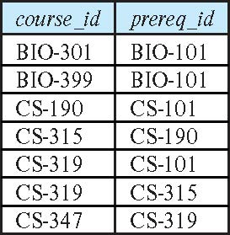
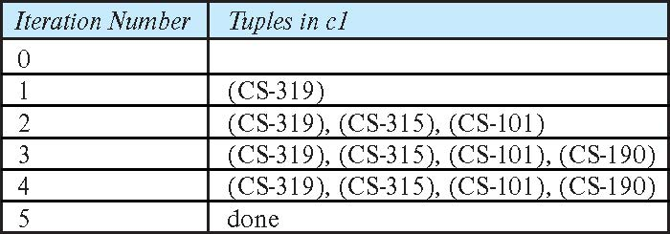
Example of Fixed-Point Computation

Slide 82
End of Chapter 5

Slide 83
Extended E-R Features (DFF: Some Design Patterns)

Slide 84
E-R Design Decisions
The use of an attribute or entity set to represent an object.
Whether a real-world concept is best expressed by an entity set or a relationship set.
The use of a ternary relationship versus a pair of binary relationships.
The use of a strong or weak entity set.
The use of specialization/generalization – contributes to modularity in the design.
The use of aggregation – can treat the aggregate entity set as a single unit without concern for the details of its internal structure.
First topic we will discuss.

Slide 85
Other Aspects of Database Design
Functional Requirements
Data Flow, Workflow
Schema Evolution

Slide 86
Specialization
Top-down design process; we designate sub-groupings within an entity set that are distinctive from other entities in the set.
These sub-groupings become lower-level entity sets that have attributes or participate in relationships that do not apply to the higher-level entity set.
Depicted by a triangle component labeled ISA (e.g., instructor “is a” person).
Attribute inheritance – a lower-level entity set inherits all the attributes and relationship participation of the higher-level entity set to which it is linked.

Slide 87
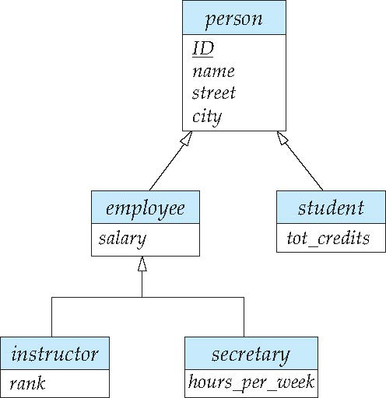
Specialization Example
Overlapping – employee and student
Disjoint – instructor and secretary
Total and partial

Slide 88
An Aside. Visual Modeling/Design Notations
REST
88 | W4111_02_S20: Introduction to Databases -- Lecture 3,4

Slide 89
Summary of Symbols Used in E-R Notation

Slide 90
Symbols Used in E-R Notation (Cont.)

Slide 91
Alternative ER Notations
Chen, IDE1FX, …

Slide 92
Alternative ER Notations
Chen IDE1FX (Crows feet notation)

Slide 93
UML
UML: Unified Modeling Language
UML has many components to graphically model different aspects of an entire software system
UML Class Diagrams correspond to E-R Diagram, but several differences.

Slide 94
ER vs. UML Class Diagrams
* Note reversal of position in cardinality constraint depiction

Slide 95
ER vs. UML Class Diagrams
ER Diagram Notation
Equivalent in UML
* Generalization can use merged or separate arrows independent
of disjoint/overlapping

Slide 96
UML Class Diagrams (Cont.)
Binary relationship sets are represented in UML by just drawing a line connecting the entity sets. The relationship set name is written adjacent to the line.
The role played by an entity set in a relationship set may also be specified by writing the role name on the line, adjacent to the entity set.
The relationship set name may alternatively be written in a box, along with attributes of the relationship set, and the box is connected, using a dotted line, to the line depicting the relationship set.

Slide 97
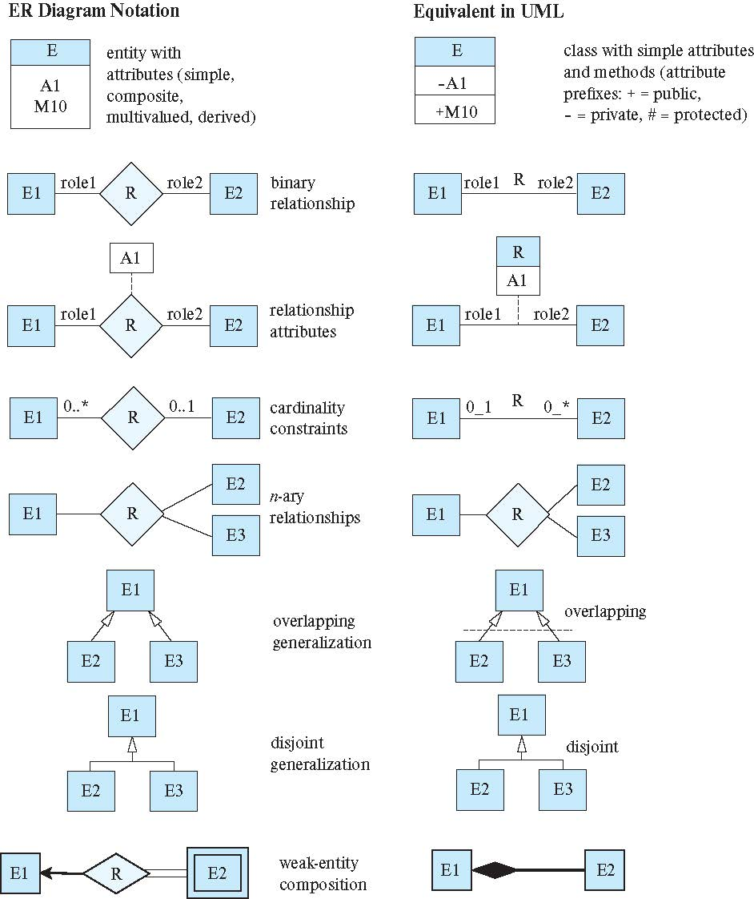
ER vs. UML Class Diagrams

Slide 98
End of Aside: Back to our Story
REST
98 | W4111_02_S20: Introduction to Databases -- Lecture 3,4

Slide 99
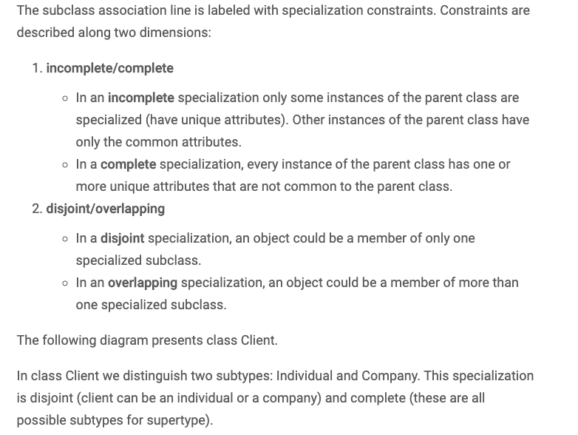
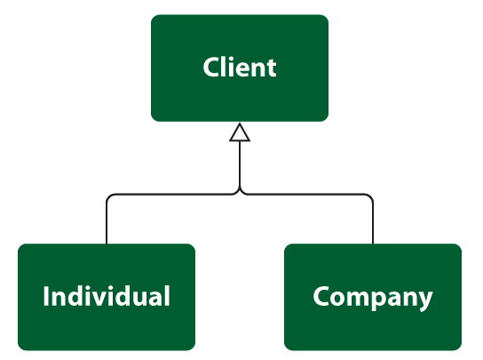
Specialization/Inheritance
99 | W4111_02_S20: Introduction to Databases -- Lecture 5

Slide 100
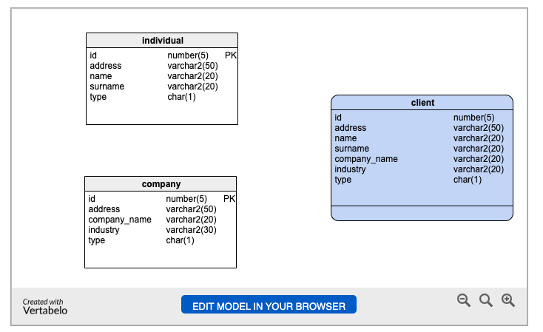
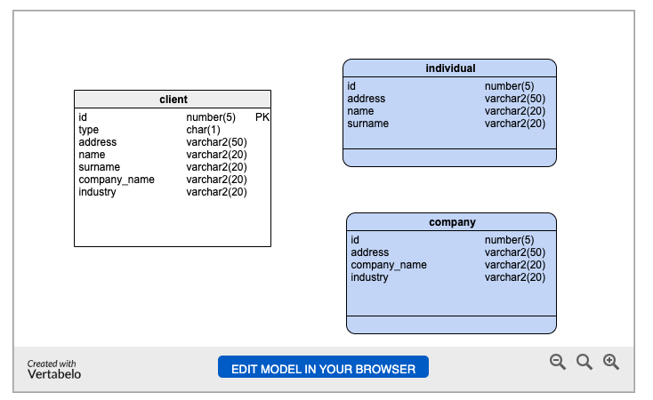
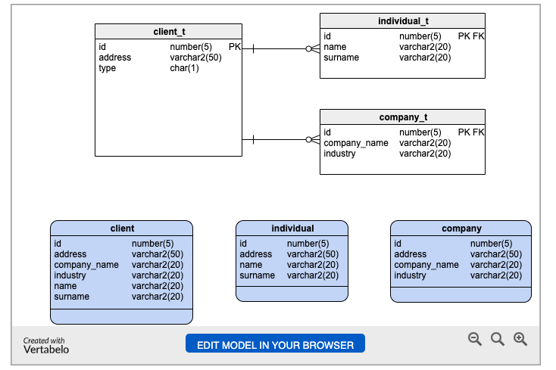
Specialization/Inheritance – Design Approaches
Two Table
One Table
Three Table
https://www.vertabelo.com/blog/inheritance-in-a-relational-database/
100 | W4111_02_S20: Introduction to Databases -- Lecture 5

Slide 101
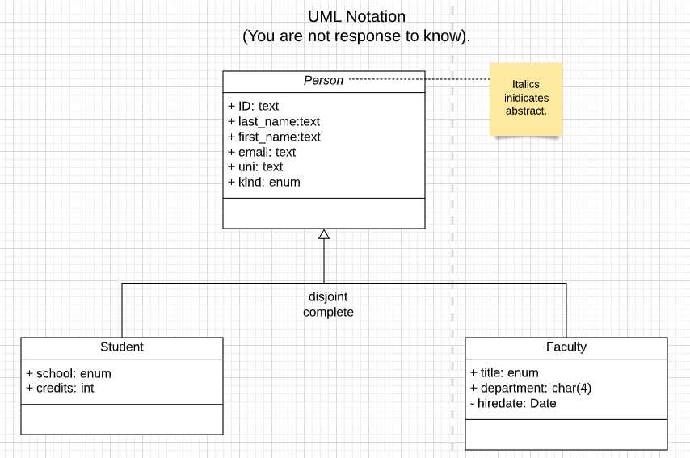
Specialization
101 | W4111_02_S20: Introduction to Databases -- Lecture 5

Slide 102
Time to Do Some Database Stuff
Back to the notebook we go, yo ho!
102 | W4111_02_S20: Introduction to Databases -- Lecture 5

Slide 103
Backup
103 | W4111_02_S20: Introduction to Databases -- Lecture 3,4

